Slide 1
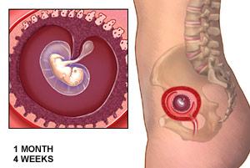
1st Month
Notes:
ONE MONTH
Fertilization
-23 Chromosomes from each parent.
Implants in the Uterus
-1/6th of an inch long
Heart
-Same as a poppy seed
-Started beating on day 18 and pumping on day 21
-You are just 4 days late for your period
4 weeks
-Eyes, Ears, and lungs begin to develop
-Even thumsucking

Slide 2
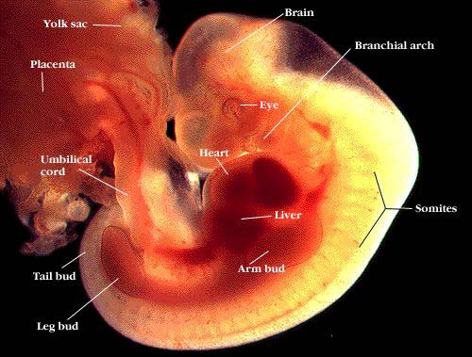

Slide 3
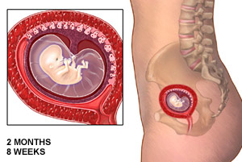
2nd Month
Notes:
TWO MONTHS
8 weeks
-1/2 inch
-muscle system develops
-baby swims in uterus
-fingers, feet, and toes developed
-transparent skin
10 weeks
-20 tiny baby teeth forming in gums
- baby squints
- swallows
- moves tongue
brain waves can be measured

Slide 4
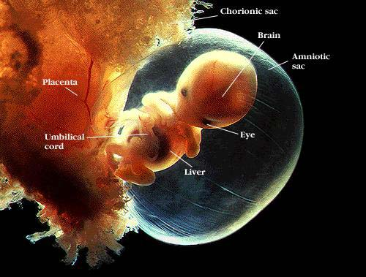

Slide 5
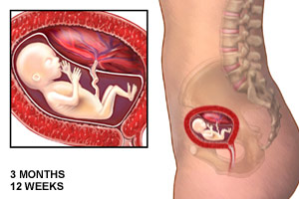
3rd Month
Notes:
THREE MONTHS
Now in fetal stage
-2.5 to 3 inches
-Can hear heart rate with Doppler

Slide 6
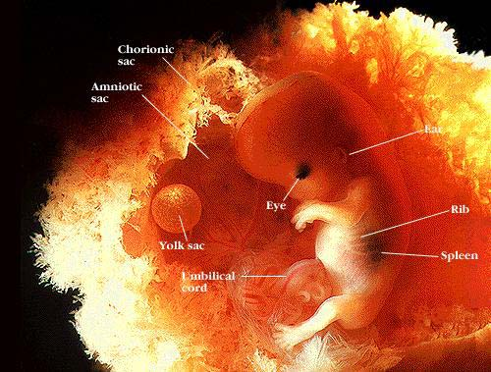

Slide 7
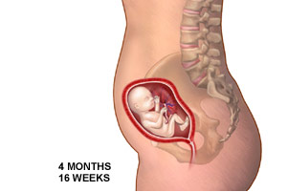
4th Month
Notes:
FOUR MONTHS
- Downy Hair called Lanugo
- 7 inches
- fine hair, eyelashes, and fingerprints

Slide 8
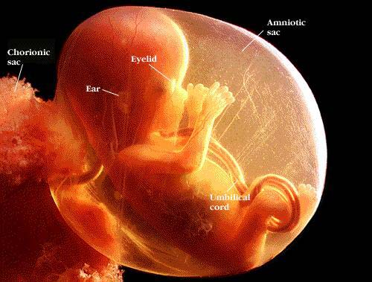

Slide 9
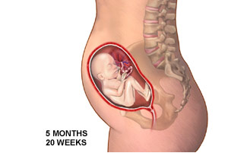
5th Month
Notes:
FIVE MONTHS
-1 pound
-Can Recognize Mom’s voice
- Can tell sex of baby
- Can feel baby

Slide 10
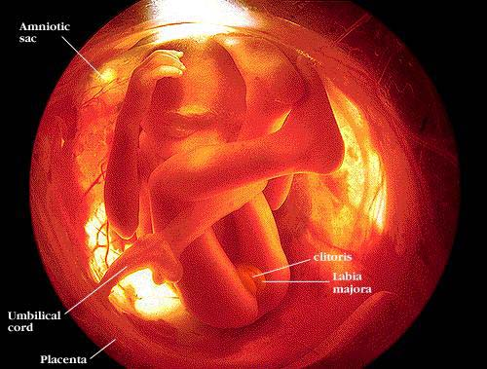

Slide 11
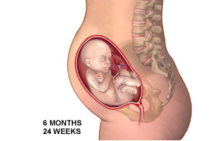
6th Month
Notes:
SIX MONTHS
-Skin covered in Vernix
- Continues to practice breathing by inhaling amniotic fluid
- eyes open for short periods of time
- Hiccups are not uncommon

Slide 12
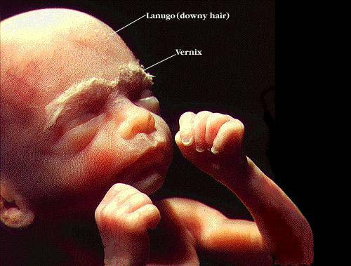

Slide 13
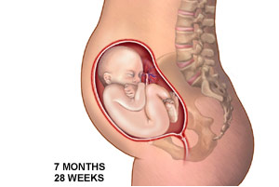
7th Month
Notes:
SEVEN MONTHS
- 14-16 inches
- organs maturing
- taste buds developed

Slide 14
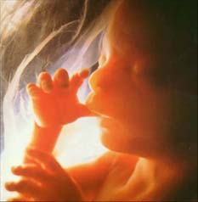

Slide 15
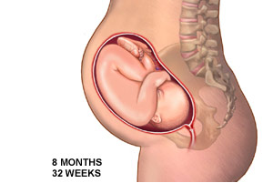
8th Month
Notes:
EIGHT MONTHS
-Fast growth
-Possible Half Pound a Week
- Can see movements on the outside
- Lungs last to develop

Slide 16
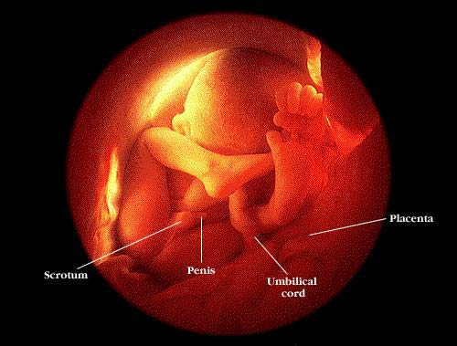

Slide 17
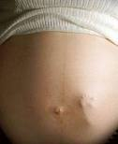

Slide 18
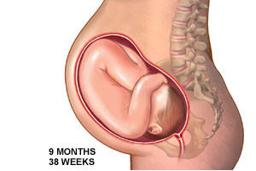
9th Month
Notes:
NINE MONTHS
-Baby lowers in abdomen
-6-9 lbs. And ready for birth

Slide 19


Slide 20
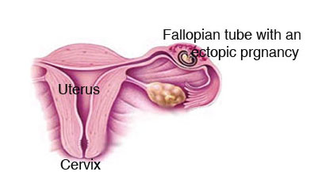
Ectopic Pregnancy
(Tubal Pregnancy)
A complication in pregnancy in which the fetus develops outside the uterus, typically in a Fallopian tube.

Slide 21
Breech Birth
Most babies are positioned head down in the womb. This is so they can come out of the birth canal (vagina) head first. Sometimes, the baby is positioned so the feet or buttocks will come out first during childbirth. This is called a breech presentation. A doctor may recommend a C-section.

Slide 22
Caesarean Section
(aka: C-Section)
A surgical procedure in which one or more incisions are made through a mother’s abdomen and uterus to deliver one or more babies.
They are usually performed when a vaginal delivery would put the baby's or mother's life or health at risk

